Slide 1

Dr Mahalingam College of Engineering & Technology
Department of Artificial Intelligence and Data Science 19ADPN6401 Mini Project
FINAL REVIEW
TITLE: PROVENDER FEEDER USING AUDRINO
BATCH NUMBER: 23BADA013
DOMAIN: INTERNET OF THINGS
TEAM MEMBERS:
KIRTHIK.S (727621BAD023)
VIGNESHWARI.K (727621BAD008)
RUTHRAPRIYAN.P (727621BAD004)
MAHATHEESH.K (727622BAD305)
GUIDE: Dr.N.SUBA RANI

Slide 2
CONTENTS:
Problem description
Findings of Literature survey
Objective
Existing System Block Diagram
Proposed System Block Diagram
Existing System VS Proposed system
Module description
Code and implementation
Snapshots
Results
Conclusion
Online Course/Contest / Publication Details
References

Slide 3
PROBLEM DESCRIPTION:
In urban areas, Pet’s possessor leave their house for the other activities.
Unable to Monitor the behaviour of the pet as they grow.

Slide 4
LITERATURE IDENTIFIED AND FINDINGS

Slide 5
1.PRODUCT DESIGN:
Product design is a technique by which translating customer’s needs into a marketable product.
It is the mandatory technique for the contact between the product and the customer
There are four core themes values in product design,which includes SOCIAL,ALURISTIC,FUNCTIONAL and ESTHETIC(SAFE).
By this SAFE value scale ,it offers an oppourtunity to puzzle out the configuration of values in a product design.
SAFE value scale must be utilized in a product design project to make sure that the product is valuable to the customer.
Reference: DESIGN AND DEVELOPMENT ON 2 IN 1 AUTOMATIC PET FEEDER BY “LIM JOE YIN”
Submitted to UNIVERSITI SAINS MALAYSIA as partial fulfillment of the requirement to graduate with honours degree in “BACHELOR OF ENGINEERING”

Slide 6
2.AUTOMATED FEEDING SYSTEM:
The abilities of communication and control technologies to improve human communication with pets is by technology “INTERNET OF THINGS”.
Smart pet feeder allows pet owners to schedule and remote their pet’s feeding time.
Automated pet feeder aids to remove waste of food as it dispenses according to time ,amount and the demand.
There are automatic pet feeder for pigeon ,cats and monkeysand tested to dispense the correct amount of food.
Most of the Automatic pet feeder includes ARDUINO which is an microcontroller types.
Automatic pet feeder gradually reduces the risk of man power.
Reference: DESIGN AND DEVELOPMENT ON 2 IN 1 AUTOMATIC PET FEEDER BY “LIM JOE YIN”
Submitted to UNIVERSITI SAINS MALAYSIA as partial fulfillment of the requirement to graduate with honours degree in “BACHELOR OF ENGINEERING”

Slide 7
3. PET NUTRITION:
Pet’s nutrition is the most important criteria as it prevents pets from obesity, gastrointestinal, indigestion and other sickness.
Dogs and cats are considered obese when their body size exceeds the ideal body size by 15% and 30% respectively (M. Osto 2015
PetMD is also an organization that provides the largest library of pet health information with vet approval. T).
Reference: DESIGN AND DEVELOPMENT ON 2 IN 1 AUTOMATIC PET FEEDER BY “LIM JOE YIN”
Submitted to UNIVERSITI SAINS MALAYSIA as partial fulfillment of the requirement to graduate with honours degree in “BACHELOR OF ENGINEERING”

Slide 8
4. INTERCONNECTION BETWEEN HUMANS AND ANIMALS:
The nature of the relationship between companion pets and their owner can have an important impact on quality of life for both pet and owner
Human and animals come into contact whenever there is an opportunity to interact. There are different qualities and quantities of communication between owners and the animals in their care.
Therefore, relationships and interaction between human and animals is important as the animals can be a cheerful companion to human
Reference: DESIGN AND DEVELOPMENT ON 2 IN 1 AUTOMATIC PET FEEDER BY “LIM JOE YIN” Submitted to UNIVERSITI SAINS MALAYSIA as partial fulfillment of the requirement to graduate with honours degree in “BACHELOR OF ENGINEERING”

Slide 9
SMART PET FEEDER:
The pets will get their food without any delay.
If the pet owner is not present then the owner doesn’t have to worry about the food intake of his/her pets
Due to this device, no one has to come from outside to provide food to the pet. So, this will be also be a safety of house.
It’s very easy to operate, no complexities involved in the process.
Very low battery power required
Reference: Smart Pet Feeder Soumallya Koley†1, Sneha Srimani1 , Debanjana Nandy1 , Pratik Pal1 , Samriddha Biswas1 , Dr. Indranath Sarkar1 1 Department of Electronics and Communication Engineering, JIS College of Engineering; Kalyani, Nadia, West Bengal .

Slide 10
IOT BASED PET FEEDER:
SMART MODE:
Smart Mode: User can define the energy fact of the food inside the tank and type of the cat. The cat‟s weight will be, further, measured and the system can compute the right amount of the food to be dispensed to cat.
CONTROL MODE:
The system can be set to control mode. Control mode allows user to dispense food with two different methods. The control mode can be run as:
1.AUTOMATIC MODE
2.CONTROL MODE
Reference: IOT based Pet Feeder [1] Raed Abdulla, [2] Ahmed Abdlekader Eldebani, [3] Sathish Kumar Selvaperumal, [4]Maythem K. Abbas [1], [2], [3] School of Engineering, Asia Pacific University of Innovation and Technology .

Slide 11
OBJECTIVE:
Provide consistent and accurate feeding
Save time and effort for pet owners
Monitor pet feeding habits
Provides vaccination schedule charts for pets

Slide 12
EXISTING SYSTEM BLOCK DIAGRAM:
FEEDER
MOTOR
WIFI
BOARD
MOBILE
BOWL
Reference:
https://youtu.be/imtcdl9jHVQ

Slide 13
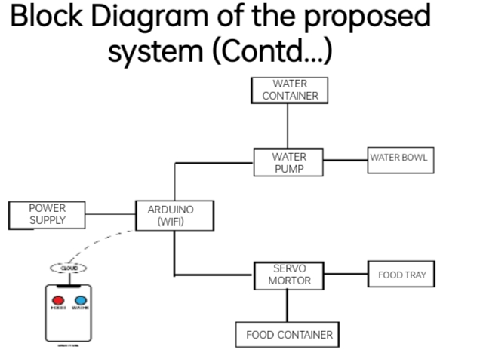
PROPOSED SYSTEM BLOCK DIAGRAM:

Slide 14
EXISTING VS PROPOSED SYSTEM :
EXISTING SYSTEM:
1.No device to sense the level of food and water level.
2.Does not contain any application oriented device.
PROPOSED SYSTEM:
1. Contains device to monitor the food and water level.
2.Application integrated device.

Slide 15
MODULE DESCRIPTION :
1.FEEDING MODULE:
Provide information on how to properly feed pets. It will cover the different types of pet food available, the recommended daily intake for pets based on their age, size, and activity level, as well as tips for maintaining a healthy diet for pets.
2.VACCINATION MODULE:
Provide information on the importance of vaccinations for pets and how to create a vaccination chart for tracking a pet's immunizations. It will cover the recommended vaccines for different types of pets, the vaccination schedule, and potential side effects of vaccines.

Slide 16
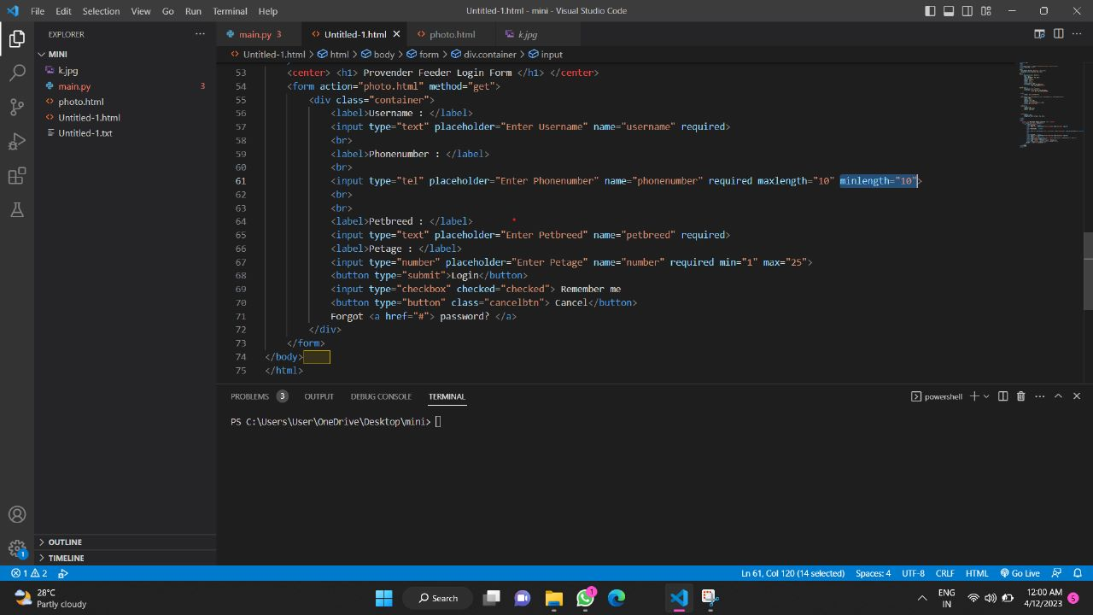
CODE AND IMPLEMENTATION:

Slide 17
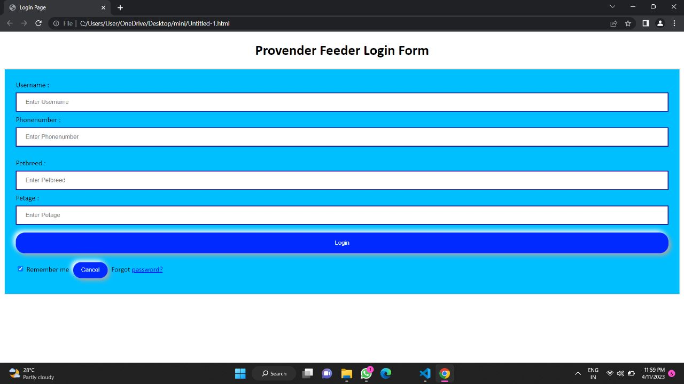
SNAPSHOTS:

Slide 18
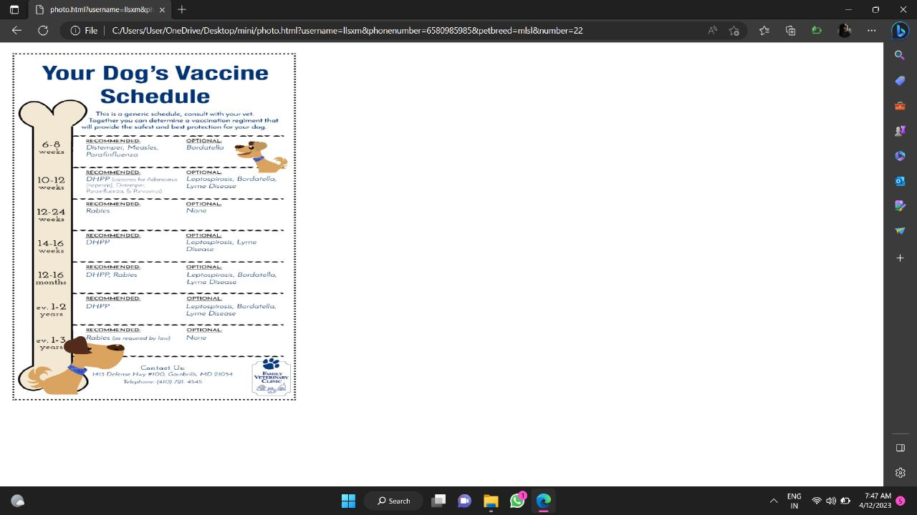
SNAPSHOTS:

Slide 19
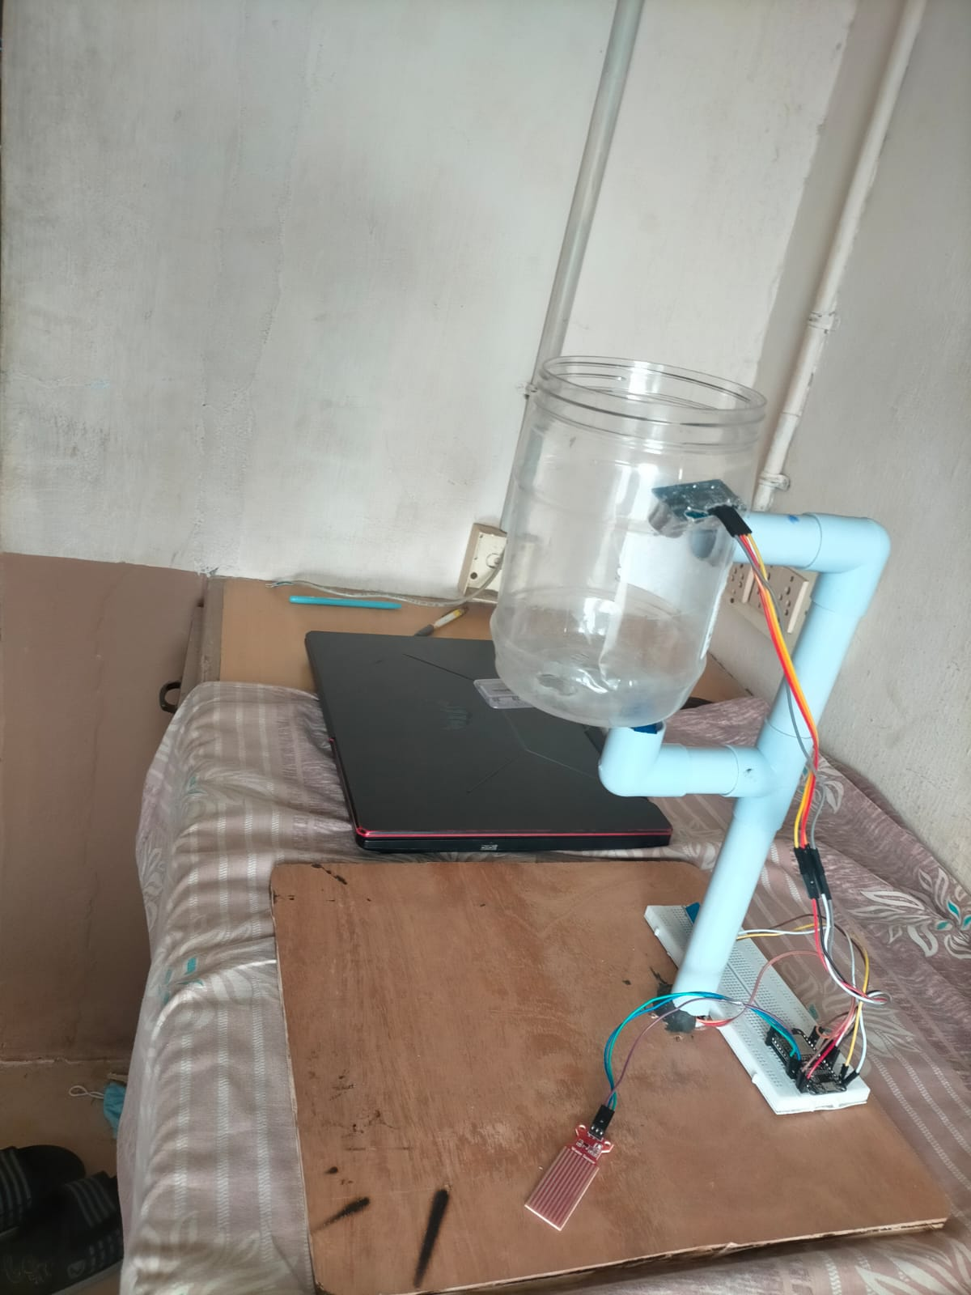
SNAPSHOTS:

Slide 20
ONLINE COURSE DETAILS :
NAME | COURSE TITLE | PLATFORM | NO: OF WEEKS | STATUS
KIRTHIK.S (727621BAD023) | DATA SCIENCE | COURSERA | 20 HOURS | COMPLETED
VIGNESHWARI.K (727621BAD008 | WEB DEVELOPMENT | SMARTKNOWER | 8 WEEKS | COMPLETED
RUTHRAPRIYAN.P (727621BAD004) | DATA SCIENCE | COURSERA | 20 HOURS | COMPLETED

Slide 21
CONTEST DETAILS:
EVENT NAME | COLLEGE NAME | DATE
PAPER PRESENTATION | ADHITHYA INSTITUTE OF TECHNOLOGY | 5.5.2023
PROJECT PRESENTATION | ADHITHYA INSTITUTE OF TECHNOLOGY | 5.5.2023

Slide 22
REFERENCES
1. The working principle of an Arduino 11th International Conference on Electronics, Computer and Computation (ICECCO)Year: 2014 | Conference Paper | Publisher: IEEE.
2. Smart Pet Feeder February 2021Journal of Physics Conference Series 1797(1):012018
3. The Study and Application of the IoT in Pet Systems January 2013Advances in Internet of Things 03(01):1-8
4.Implementation of an IoT based Pet Care Chen;Maher Elshakankiri2020 Fifth International Conference on Fog and Mobile Edge Computing (FMEC)
5. Design of Remote Pet Feeding System Based on ARM Baijie Ma;Ning Guo2020 Chinese Automation Congress (CAC)Year: 2020 | Conference Paper | Publisher: IEEE

Slide 23
REFERENCES
6. Smart dog feeder design using wireless”. By karyono,k and Nugroho ,I.H.T.
7.DESIGN OF AN AUTOMATED PET FEEDER BASED ON IOT by Xiamyang ji and yamin.
8.”DESIGN AND IMPLEMENTATION OF AUTOMATED PET FEEDER WITH IMAGED RECOGNATION” by jianhuna cai,yunpeng zhu.
9.”A SMART PET FEEDER BASED ON FUZZY CONTROL” by ming fang chai and jia-yulti.
10. “DEVELOPMENT OF AN AUTOMATIC PET FEEDER SYSTEM USING MICROCONTROLLER” by Noraziah Ahmed.

Slide 24
THANK YOU!!

